Slide 1
Supersonic Gas Ejector Design and Performance Evaluation Muhammad Hazim Bin Sulaiman (A0155095B)

Slide 2
Content
Introduction to Supersonic Gas Ejectors
Problem Statement
ESDU 84029
Methodology
Results and Discussion
Methane
Performance evaluation
Conclusion and Future Work

Slide 3
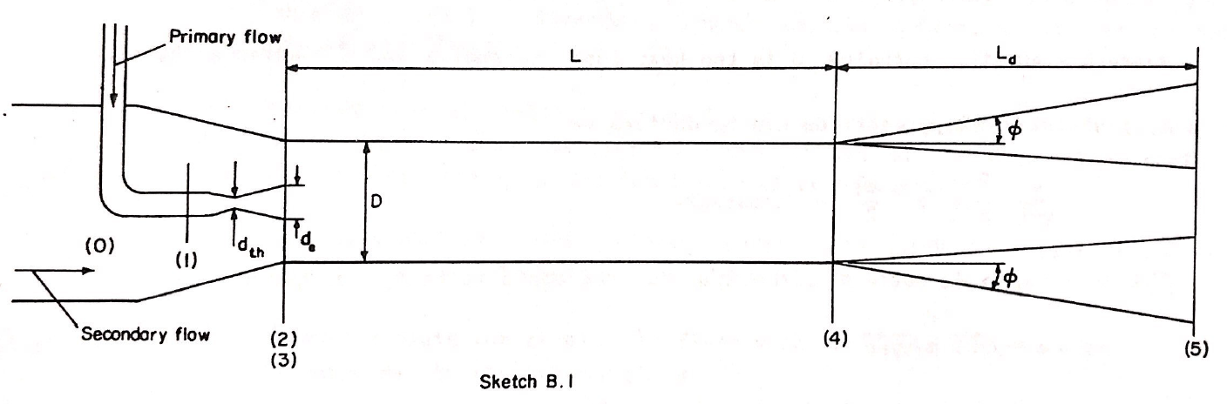
Introduction to Supersonic Gas Ejectors
Gas ejectors are used in many appliances throughout many industries. It is an appliance that draws the pressure energy from a high-pressure motive stream to entrain the low pressure stream from a secondary source

Slide 4

Notes:
velocity change in area equation for isentropic flow

Slide 7
Notes:
Recover pressure

Slide 8
Main subscripts
0 – secondary flow entry plane
1 – primary nozzle entry plane
2 – primary nozzle exit plane
3 – mixing duct entry plane
4 – mixing duct exit plane
5 – diffuser exit plane
Other subscripts
e – primary nozzle exit
th – primary nozzle throat
“ – secondary stream
‘ – primary stream
Notes:
Vital planes and areas are denoted from 0 to 5

Slide 9
Problem Statement
Investigate the design conditions of a supersonic gas ejector with methane as a medium
Design condition is set to be the best diffuser diameter that outputs the highest pressure past the diffuser exit
The mathematical model will then be used for performance evaluation

Slide 10
ESDU 84029
Ejectors and jet pumps: Design and performance for compressible flow
Quick Design Method and Detailed Design Method
However, these methods are only applicable if the medium is air
Equations are provided in the appendix of the ESDU84029 that are used to find the pressures within the gas ejector

Slide 11
Methodology
Operating Conditions
Fixed Parameters
Equations
Calculations

Slide 12
Operating Conditions
Primary |  | Secondary |  | Mixing Duct
T_{p} (in Celsius) | 25 | T_{s} (in Celsius) | 25 | T₄ (in Celsius) | 25
T_{p} (in Kelvin) | 298 | T_{s} (in Kelvin) | 298 | T₄ (in Kelvin) | 298
P₁ (in Pa) | 5.00E+05 | P₀ (in Pa) | 4.00E+04
Mass FR (in kg/s) | 1 | Mass FR (in kg/s) | 0.2 | Mass FR (in m³/s) | 1.2
Volumetric FR (in m³/s) | 1.225 | Volumetric FR (in m³/s) | 0.245

Slide 13
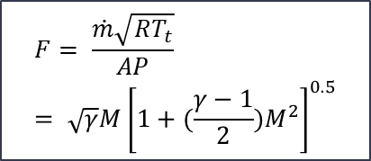
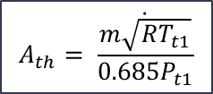
Fixed Parameters
Main subscripts
0 – secondary flow entry plane
1 – primary nozzle entry plane
2 – primary nozzle exit plane
3 – mixing duct entry plane
4 – mixing duct exit plane
5 – diffuser exit plane
Other subscripts
e – primary nozzle exit
th – primary nozzle throat
“ – secondary stream
‘ – primary stream
Diameters (in mm) |  | Areas (in m^2)
D0 | 200 | A0 | 0.031415
D1 | 60 | A1 | 0.002827
Dth | 23.97252 | Ath | 0.000451
De | 33.90226 | Ae | 0.000903
D2 | 100 | A2 | 0.007854
D3 | 150 | A3 | 0.017671
D3' | 33.90226 | A3’ | 0.000903
D3" | 116.0977 | A3” | 0.010586
D4 | 150 | A4 | 0.017671
D5(to be varied) | - | A5 | -
$$A_{th}= \frac{\dot{m\sqrt{RT_{t1}}}}{0.685P_{t1}}$$
$$F= \frac{\dot{m}\sqrt{RT_{t}}}{AP}= \sqrt{γ}M{\left[1+(\frac{γ−1}{2})M^{2}\right]}^{0.5}$$

Slide 14
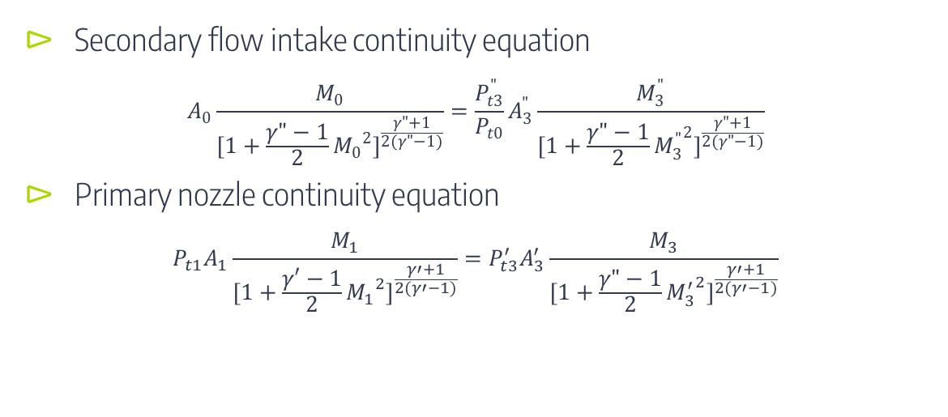
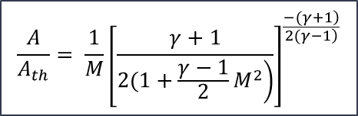
Equations
Secondary flow intake continuity equation
$$A_{0}\frac{M_{0}}{{[1+\frac{γ"−1}{2}{M_{0}}^{2}]}^{\frac{γ"+1}{2(γ"−1)}}}=\frac{P_{t3}^{"}}{P_{t0}}A_{3}^{"}\frac{M_{3}^{"}}{{[1+\frac{γ"−1}{2}{M_{3}^{"}}^{2}]}^{\frac{γ"+1}{2(γ"−1)}}}$$
Primary nozzle continuity equation
$$P_{t1}A_{1}\frac{M_{1}}{{[1+\frac{γ′−1}{2}{M_{1}}^{2}]}^{\frac{γ′+1}{2(γ′−1)}}}=P_{t3}^{′}A_{3}^{′}\frac{M_{3}}{{[1+\frac{γ"−1}{2}{M_{3}^{′}}^{2}]}^{\frac{γ′+1}{2(γ′−1)}}}$$
$$\frac{A}{A_{th}}= \frac{1}{M}{\left[\frac{γ+1}{\left.2(1+\frac{γ−1}{2}M^{2}\right)}\right]}^{\frac{\left.−(γ+1\right)}{\left.2(γ−1\right)}}$$

Slide 15
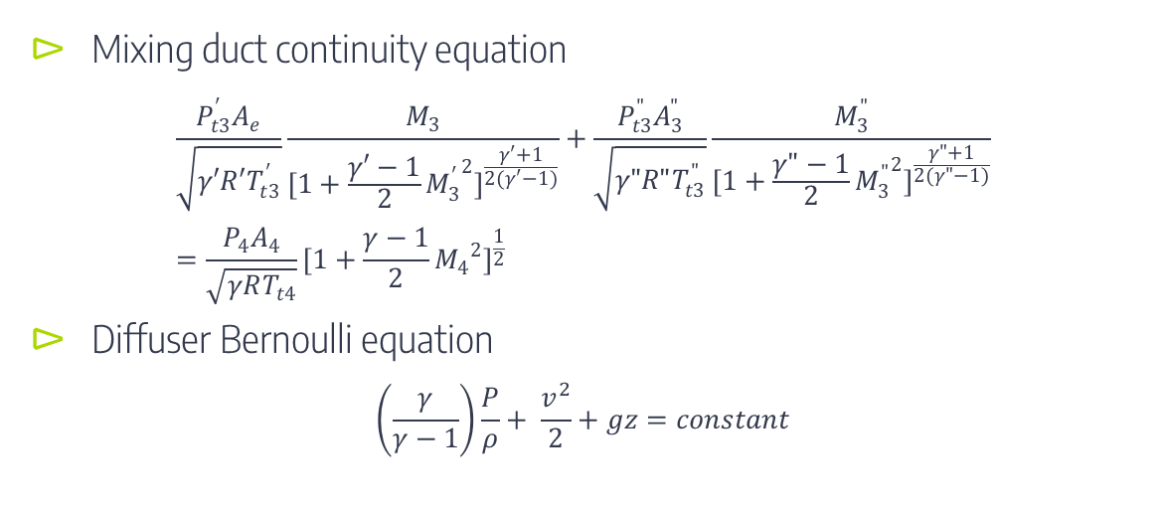
Equations
Mixing duct continuity equation
$$\frac{P_{t3}^{′}A_{e}}{\sqrt{γ′R′T_{t3}^{′}}}\frac{M_{3}}{{[1+\frac{γ′−1}{2}{M_{3}^{′}}^{2}]}^{\frac{γ′+1}{2(γ′−1)}}}+\frac{P_{t3}^{"}A_{3}^{"}}{\sqrt{γ"R"T_{t3}^{"}}}\frac{M_{3}^{"}}{{[1+\frac{γ"−1}{2}{M_{3}^{"}}^{2}]}^{\frac{γ"+1}{2(γ"−1)}}}=\frac{P_{4}A_{4}}{\sqrt{γRT_{t4}}}{[1+\frac{γ−1}{2}{M_{4}}^{2}]}^{\frac{1}{2}}$$
Diffuser Bernoulli equation
$$\left(\frac{γ}{γ−1}\right)\frac{P}{ρ}+ \frac{v^{2}}{2}+gz=constant$$

Slide 16
Calculations
Calculations are done through excel
Physical variables of air is used first and validated
Following that, values of methane are used

Slide 17
Results
Graph of diffuser exit pressure (P_{t5}) against diffuser diameter (D₅)
Validation
Cross-check to values found in ESDU 84029
Methane
Translate physical values to methane values

Slide 18
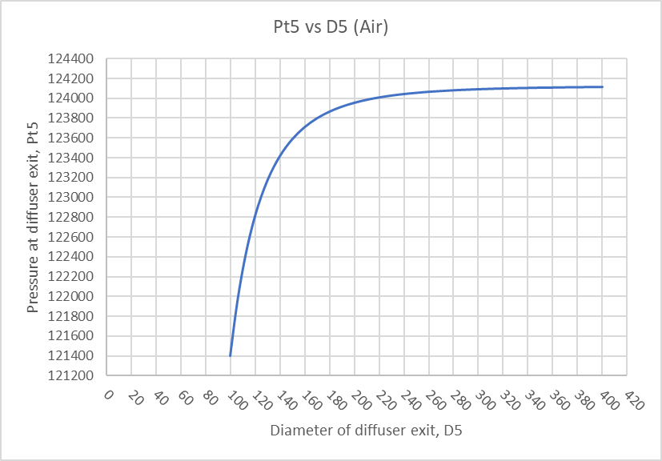

Graph of diffuser exit pressure (P_{t5}) against diffuser diameter (D₅)
Maximum pressure: 124100 Pa
Chosen diameter: 220mm
124000Pa (99.9% efficiency)
$$Efficiency= \frac{Pressure at stated exit diameter}{Maximum Pressure}×100\%$$

Slide 19
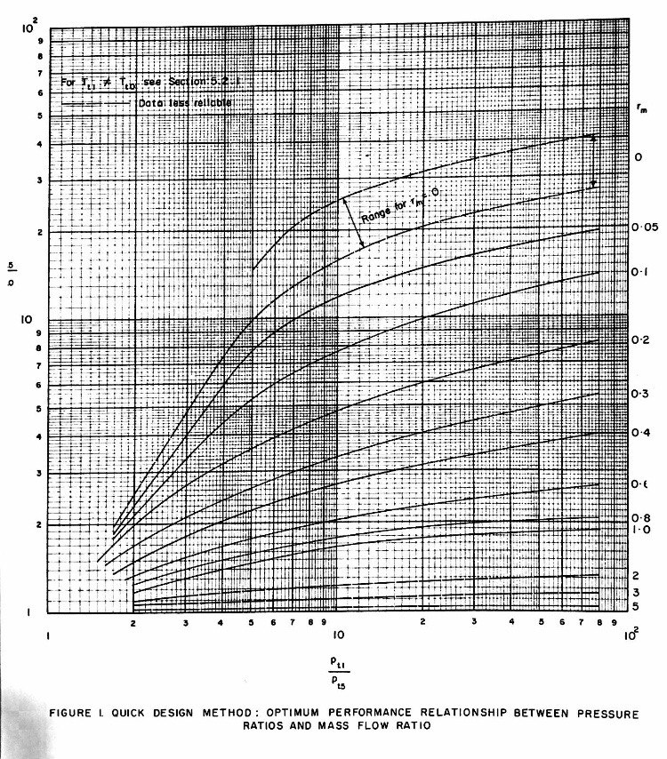

Validation
Graph of Optimum Performance Relationship Between Pressure Ratios and Mass Flow Ratio from ESDU 84029
$$r_{m}= \frac{\dot{m"}}{\dot{m′}}$$
 | Expected (Obtained from ESDU 84029) | Calculated
P_{t1}/P_{t5} | 4 | 4.04
P_{t5}/P_{t0} | 3.2 | 3.1

Slide 20
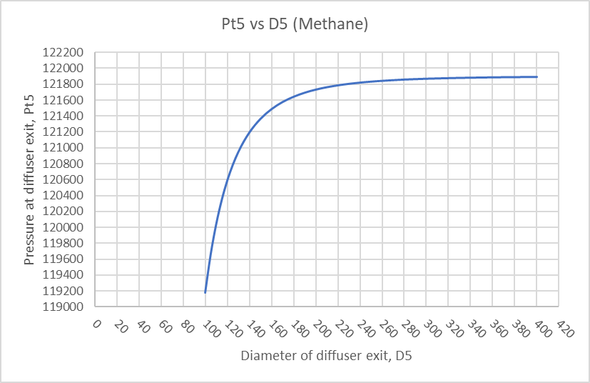
Methane
Maximum pressure: 121900 Pa
Chosen diameter: 185 mm
121656 Pa (99.8% efficiency)

Slide 21
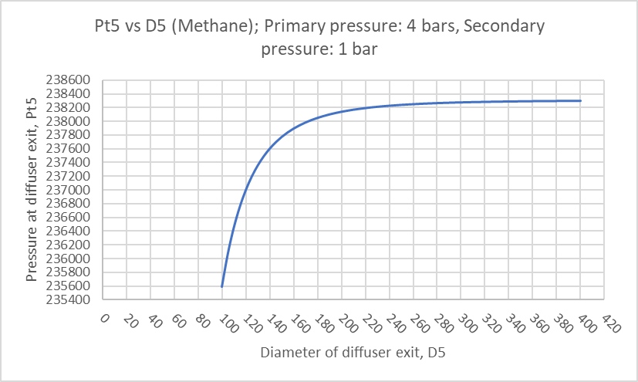
Performance Evaluation
Mathematical model is set in the excel sheet
By changing values of dimensions, operating conditions and physical variables (eg. Specific heat ratio & Density), the corresponding graph will be produced

Slide 22
Conclusion
Investigate the design conditions of a supersonic gas ejector with methane as a medium
Design condition is set to be the best diffuser diameter that outputs the highest pressure past the diffuser exit
The mathematical model will then be used for performance evaluation
Future work
CFD
Physical experiment

Slide 23
Thank You

Slide 24
Flow Chart
Primary nozzle continuity equation
Input P_{t1} to obtain P_{t3}”
Mixing duct continuity equation
Input P_{t3}’ & P_{t3}” to obtain P_{t4}
Diffuser continuity equation
Input P_{t4} and vary D₅ to obtain P_{t5}
Secondary flow intake continuity equation
Input P_{t0} to obtain P_{t3}’

Slide 25
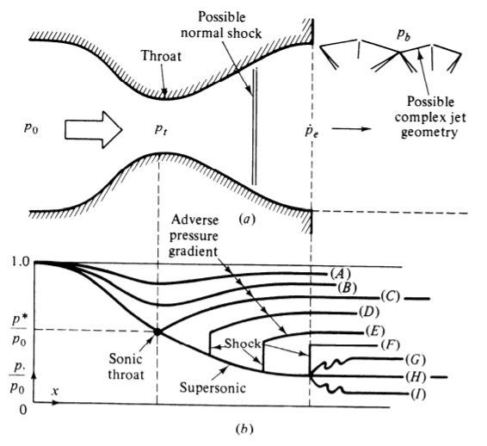

Slide 26
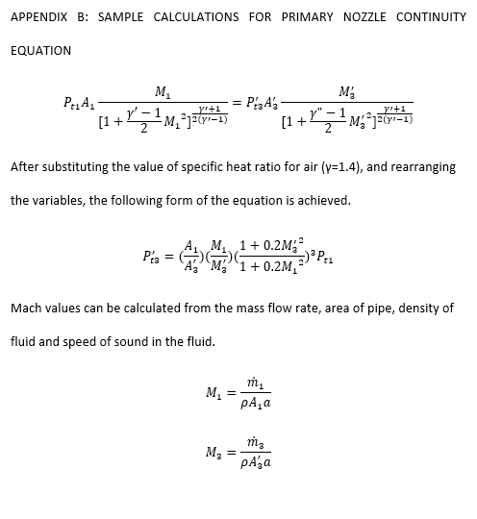

Slide 27
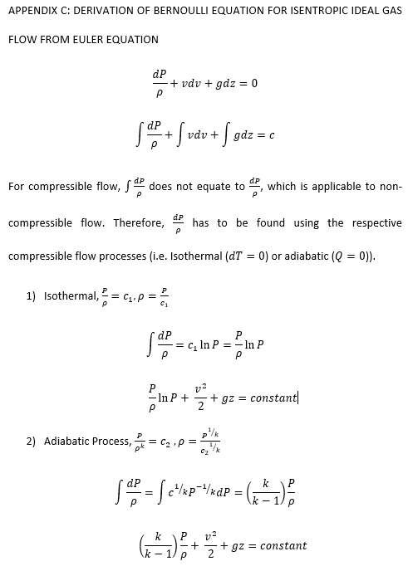

Slide 28


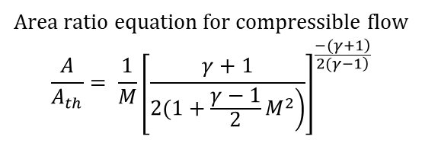
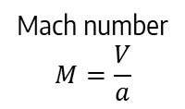
Velocity of sound
$$a= γ∗R∗T$$
Mach number
$$M=\frac{V}{a}$$
Static pressure based mass flow function
$$F= \frac{\dot{m}\sqrt{RT_{t}}}{AP}= \sqrt{γ}M{\left[1+(\frac{γ−1}{2})M^{2}\right]}^{0.5}$$
Area ratio equation for compressible flow
$$\frac{A}{A_{th}}= \frac{1}{M}{\left[\frac{γ+1}{\left.2(1+\frac{γ−1}{2}M^{2}\right)}\right]}^{\frac{\left.−(γ+1\right)}{\left.2(γ−1\right)}}$$

Slide 29
 | Expected (Obtained from ESDU 84029) | Calculated
P_{t1}/P_{t5} | 4 | 4.04
P_{t5}/P_{t0} | 3.2 | 3.1

